Slide 1
Self-care and Wellness in Graduate School
BGS Orientation
August 20, 2020
Notes:
Pictures in Folder will help bring color and context to the slides

Slide 2
About the Peer Support Network
Mission Statement
It is the mission of the Peer Support Network to provide individualized emotional and social support to fellow peers within the Biomedical Graduate Studies program. In addition to serving our peers-in-need, we aim to establish a greater sense of community & connectedness within the BGS program.
PSN Structure:
One-on-one counseling
Town-hall style group discussions
Visit our new website for more information! https://www.med.upenn.edu/bgs/psn.html
Notes:
Hannah
Our goal is to have a team of volunteers who will each take an active role in providing support to our peers
Peers searching for support will complete an online submission form through our new website. They’ll then be connected to a volunteer who will provide confidential support through video calls, phone calle, emails, or text messaging.
During one-on-one sessions, assigned PSN volunteers will provide individual mentorship, a listening ear, and advice or suggestions to help their peers.
PSN group discussions offer an opportunity for students to connect with other PhD students. We envision that our peers will gain comfort and support from others who may be experiencing similar stressors.
Group discussions will be themed, for example, “Mindfulness during research resumption,” and will include lessons and exercises curated by PSN volunteers in consultation with CAPS and BGS administration.

Slide 3
Outline of Today’s Session
2:00PM - 2:40PM Presentation on Wellness and Self-care
2:40PM - 3:00PM Break (please remain on Blue Jeans during this break!)
3:00PM - 3:45PM Breakout Sessions
3:45PM - 4:00PM Wrap Up
5:00PM - 6:00PM PSN-led Student Social
Notes:
Hannah
Idea of what they can expect from today - all are approximations
Going over concepts you may or may not have heard before -- give them the option to interject with questions in chat box, may feel more comfortable to ask questions in chat because they’re uncomfortable topics

Slide 4
Outline of Today’s Presentation
Introduction to wellness
How to combat Imposter Syndrome
Developing healthy coping mechanisms
Tips for self-care and mindfulness
Notes:
Hannah

Slide 5
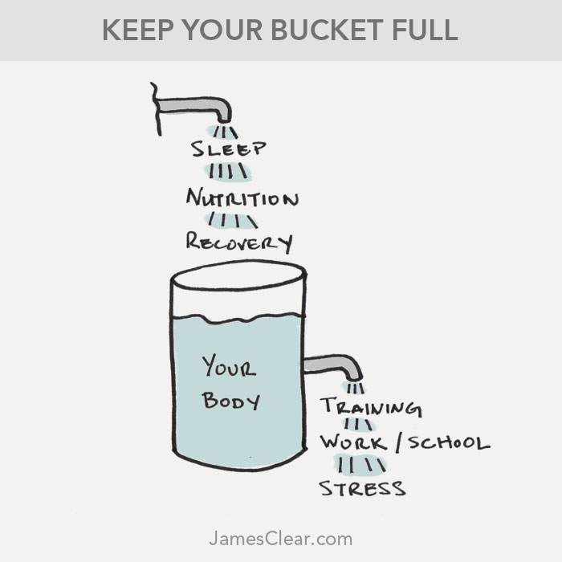
Challenges to wellness in graduate school
Balancing course work and lab work
Managing mentor-mentee relationships
Coping with self-imposed stress
Combatting Imposter Syndrome
Notes:
Hannah, Gaby, Neha, Lindsay
We’ll all take this slide - describe a stressor that we’ve experienced and how we used wellness/self-care/coping mechanisms to overcome those stressors, we can also talk about why we feel wellness/self-care is important
End on a positive note, we’re here for you -- we have a network at Penn to support each other
Can explain that we’ve all experienced stress, and we’ve all come out the other side. We’ve learned (and are continuing to learn) how to combat imposter syndrome, use effective coping mechanisms, and practice self-care and mindfulness to work through stresses and maintain wellness.
Ideas:
Stress from balancing coursework and labwork
Stress from mentor/mentee relationship
Stress due to feelings of belonging and/or Imposter syndrome
People in industry may feel nervous starting classes again when returning to graduate school
Some new students may feel nervous about starting a new subject (i.e. if they’re switching into biology)
Self-made stress -- I’m falling behind (haven’t published yet, usually stems from comparing ourselves to others)
On this slide - highlight that we’re students too -- we’re not experts
Give general experiences, anecdotes → do this so we can talk about solutions, these stressors didn’t overcome us -- we’re still here

Slide 6
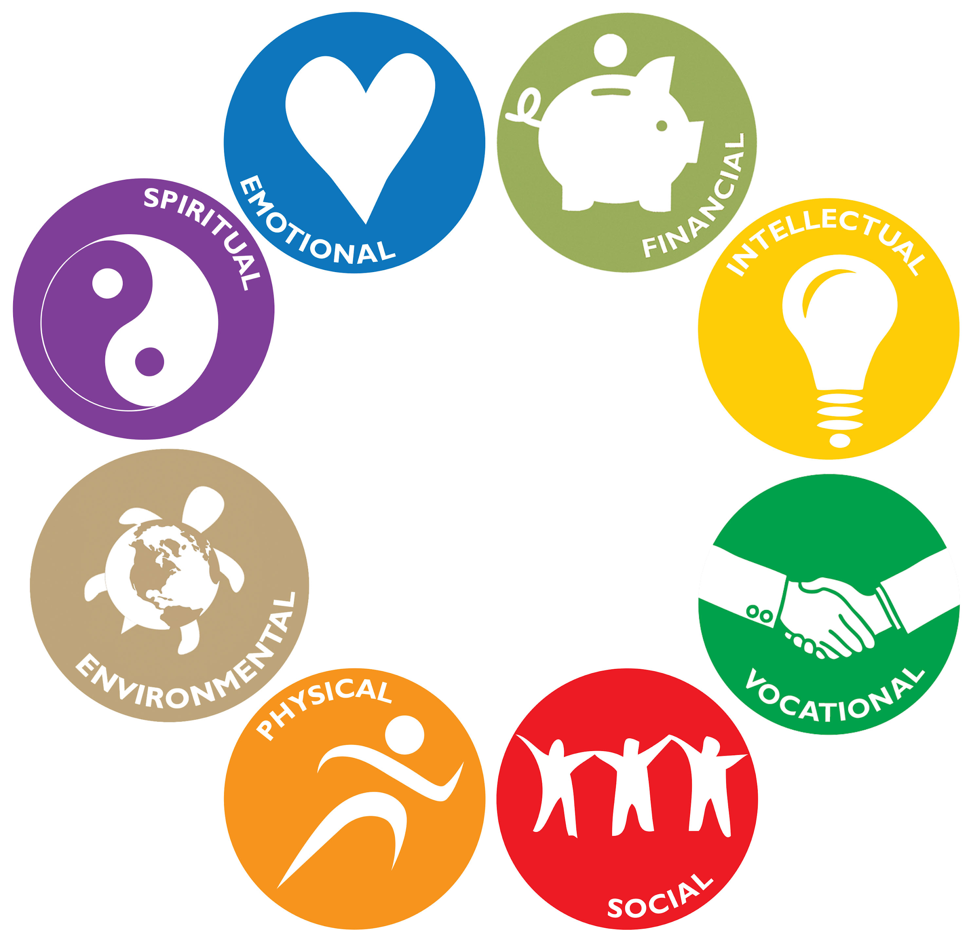
How do we define wellness?
Wellness: an active process of becoming aware of and making choices toward a healthy and fulfilling life
There are eight dimensions of wellness
https://umwellness.wordpress.com/8-dimensions-of-wellness/
Notes:
Hannah
Acknowledge that talking about wellness and self-care can be uncomfortable, but that we can use this situation (the pandemic) as an opportunity for positive change, to develop a willingness (and to develop a dialogue) to talk about health and wellness in science
We define wellness as an active process of becoming aware of and making choices towards a healthy and fulfilling life. Wellness is more than being free from illness or disease, it’s the dynamic process of change and growth that we carry with us through everyday life.
There are eight dimensions of wellness, which are shown here in this image. Wellness encompasses occupational, emotional, spiritual, environmental, financial, physical, social, and intellectual. Each dimension of wellness is interrelated with another and each dimension is equally important to maintain balance in our lives.
So for example, physical wellness means choosing things that make our body feel good like regular exercise and proper nutrition, and trimming down on the things that bring us down such as inadequate sleep.
Emotional wellness refers to our ability to understand and deal with both positive and negative emotions, to learn and grow from experiences, and develop techniques of self-care and stress reduction
Social wellness encompasses our ability to build healthy and supportive relationships, foster genuine connections, and offer support to others during difficult times
Occupational (or vocational): our ability to achieve work-life balance which is really important in graduate school. We want to do work that is motivating and interesting, and achieve a sense of personal satisfaction in the workplace.
Spiritual: promotes living a life that reflects our deepest values and beliefs by finding meaning in life events, developing individual purpose, and creating time for spiritual practices like meditation, journaling, prayer or personal reflection.
It’s state of being physically, mentally, and socially well. And when we think about wellness, we want to think of it more as a lifestyle and how we live our everyday life, rather than an end to be achieved.
Intellectual: many things that keep our brain active, able to realize our abilities, cope with stress, and work productively.
Environmental
Financial

Slide 7
Why is wellness important for graduate students?
In order to do well, we need to be well
To be a good scientist, we need to attend to our mental, physical, and emotional wellness
Wellness is the foundation for being a resilient scientist
Resilience is the ability to adapt and grow through adversity
https://studentaffairs.duke.edu/duwell/what-wellness
Notes:
In order to do well, we need to be well. So, we can’t do our best work in lab if we’re not attending to our physical health by getting enough sleep and eating nutritious meals.
Wellness can also help us develop resilience and to deal with setbacks, challenges, or stresses in a healthy way. To be resilient means to adapt and grow through adversity and challenging times. Graduate school and pursuing a PhD can be a huge undertaking, with many stresses. We also experience stress outside of lab or coursework - stress is also a unavoidable part of life, as we’re experiencing now living through the pandemic. So, by developing wellness and a self-care routine we can develop our resilience and be better equipped to navigate these tough situations and find a constructive way forward
And even though we’re here to be trained as scientists, it’s important to recognize that we’re not robots. We’re people whose health and well-being are comprised of the physical, mental, and emotional. All of these aspects of our health are not mutually exclusive and they each hold equal importance.
And by attending to all dimensions of our wellness, we can be better equipped to subdue stress

Slide 8
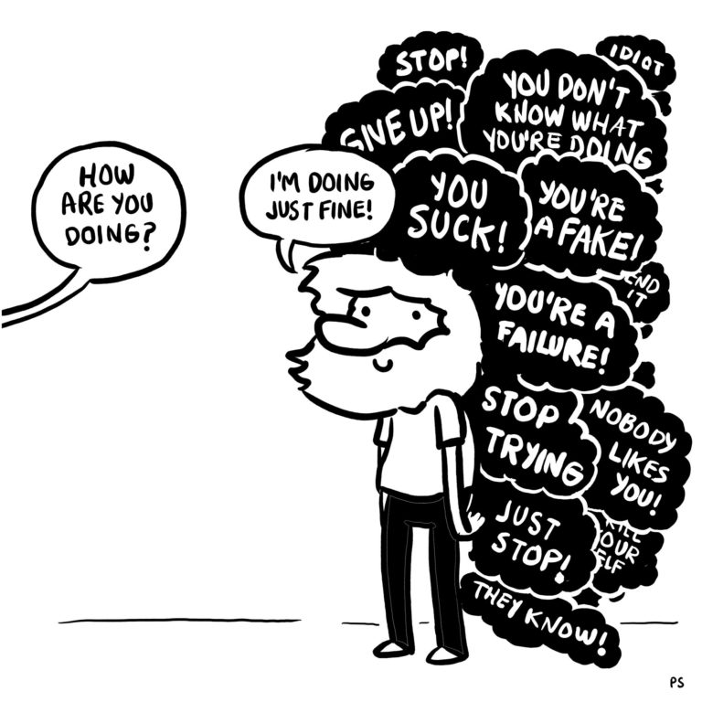
Imposter Syndrome: a common barrier to wellness
Imposter Syndrome: the feeling of phoniness in people who believe they are not intelligent, capable, or creative despite evidence of high performance
Notes:
Lindsay
Transition to this topic by explaining that imposter syndrome can be a barrier to our personal wellness and can impede our growth as scientists
Imposter syndrome = psychological pattern of an individual doubting their accomplishments or talents
Important points to highlight on this slide
Someone with imposter syndrome may have a persistent internalized fear of being exposed as a "fraud" (this graphic on the right really shows this internalized fear because they respond with I’m doing just fine but what they really feel inside is breaking them down)
Imposter syndrome leads us to feel that we don’t belong
And we need to feel like we belong so that we learn, grow, and take risks
Example: if we experience imposter syndrome, we may want to “fly below the radar” so we may not ask questions, may not ask for what we need → hindering our growth
Someone with imposter syndrome may:
Feel like a fake
Attribute success to luck
Discount your successes
Assume you had to work hard and it was easy for everyone else
Have a fear of failure
Perfectionist
Compare ourselves to others
Imposter syndrome is incredibly widespread within science and academia (~70% of people experience imposter syndrome), you’re not alone

Slide 9
How do we combat imposter syndrome?
Self-efficacy: the belief in one’s ability to succeed
People with strong self efficacy tend to:
View challenging problems as tasks to be mastered
Develop deeper interest in activities
Form a strong sense of commitment to their interests
Recover quickly from setbacks or disappointments
We can develop self-efficacy by:
Watching other people complete a task that’s causing us anxiety
Take small steps towards learning the task
Having the opportunity to actually complete the task with assistance
Notes:
One of the ways we combat imposter syndrome is developing self-efficacy, or the belief in our own ability to succeed.
How can we develop self-efficacy?
Mastery experience - having the opportunity to successfully complete the task with assistance.
Vicarious experience - watching other people (our labmates, friends, colleagues) successfully learn and do the task will make you feel more confident
Physiological state - Successfully learning the task will make you feel less anxious about doing it on your own (set small, reasonable goals to learn the task)

Slide 10
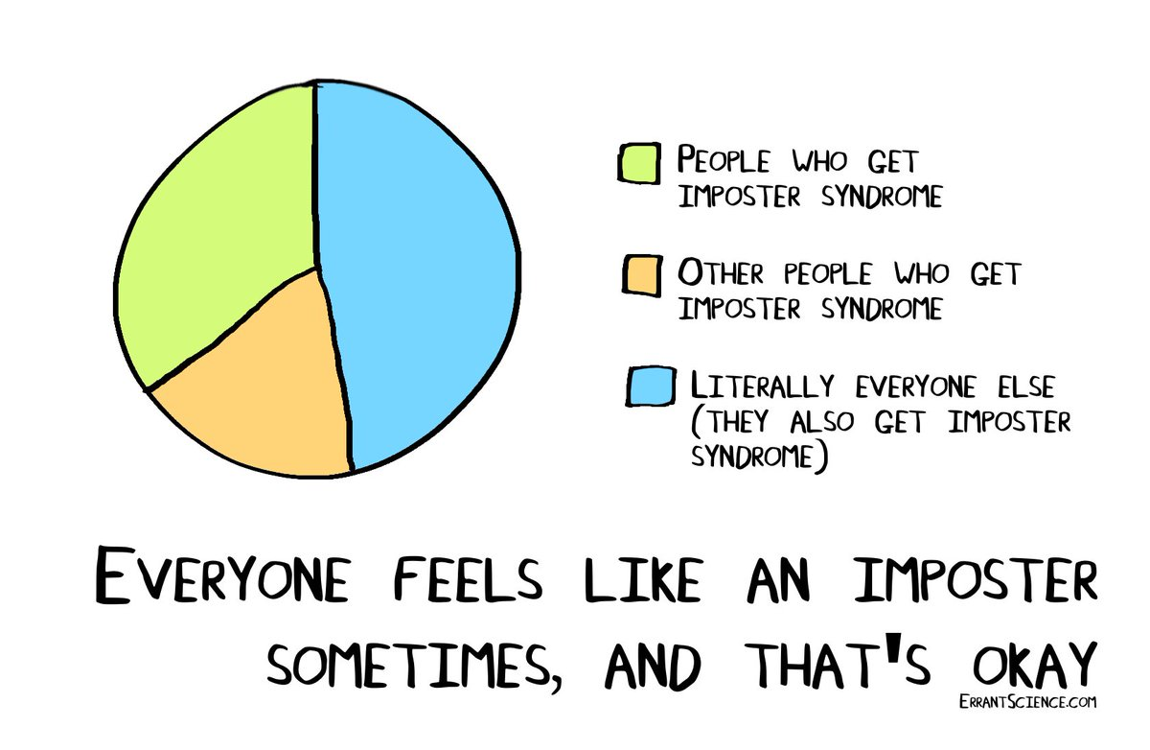
How do we combat imposter syndrome?
Develop self-efficacy
Talk about your fears with trusted family, friends, and mentors
Develop a new script
Be curious
Find a counselor to learn skills to deal with these fears
Develop healthy coping mechanisms and self-care practices
Notes:
Lindsay
Self-efficacy: the belief in one’s ability to succeed
People with strong self efficacy tend to:
View challenging problems as tasks to be mastered
Develop deeper interest in activities
Form a strong sense of commitment to their interests
Recover quickly from setbacks or disappointments
We can develop self-efficacy by:
Watching other people complete a task that’s causing us anxiety
Take small steps towards learning the task
Having the opportunity to actually complete the task with assistance
Talk about your fears with trusted family, friends, and mentors
Break the silence → knowing that you’re not alone can be tremendously freeing
imposter syndrome is just one example of the stresses we may experience as graduate students. It’s therefore important to develop healthy coping mechanisms and self-care practices in order to deal with these stresses
Develop a new script
Our script is that automatic mental tape that starts playing in situations that trigger your imposter feelings.
When starting a new job/project, instead of thinking “wait till they find out I have no idea what I’m doing”, try thinking “Everyone who starts something new feels off-base in the beginning. I may not know all the answers but I’m smart enough to find them out.”
Overtime, you’ll begin to believe the new thoughts. Reframe the situation/your thinking to talk your way down faster, so you can an “imposter moment” instead of an “imposter life”
Be curious:
Why am I feeling this way?
What evidence do I have that these fears are true?
The only way to stop feeling like an impostor is to stop thinking like an impostor.
https://impostorsyndrome.com/10-steps-overcome-impostor/ (helpful website)

Slide 11
Developing healthy coping mechanisms
When feeling stressed, our resources for coping are surpassed
Developing coping self-efficacy can help us lower our stress level
Recognize that you are experiencing stress
Assess whether the stressful situation is changeable or unchangeable
Utilize effective coping strategies given the type of situation
Notes:
Gabriela
It’s important to learn how to cope with stress in a healthy manner. When we feel stressed our resources for coping are surpassed. Developing coping self-efficacy (confidence to cope effectively with stress), is one thing we can do to help lower our stress level as we work to persist and succeed in school
www.verywellmind.com/forty-healthy-coping-skills-4586742
Coping skills can help you tolerate, minimize, and deal with stressful situations in life.
Managing your stress well can help you feel better physically and psychologically and it can impact your ability to perform your best.
But not all coping skills are created equal. Sometimes, it’s tempting to engage in strategies that will give quick relief but might create bigger problems for you down the road.
It’s important to establish healthy coping skills that will help you reduce your emotional distress or rid yourself of the stressful situations you face.
When you’re feeling distressed, ask yourself, “Do I need to change my situation or do I need to find a way to better cope with the situation?” Then, you can decide which type of coping strategy will help you best proceed.
The first step towards coping is to recognizing that you are experiencing stress
Next it is important, to assess whether the situation is changeable or unchangeable
Identifying whether the situation is changeable determine what style of coping will help most
Most challenging situations are changeable → starting out with poor grades is changeable
Unchangeable situations are less common, but can be impactful. For example, the losses faced due to COVID-19 pandemic

Slide 12
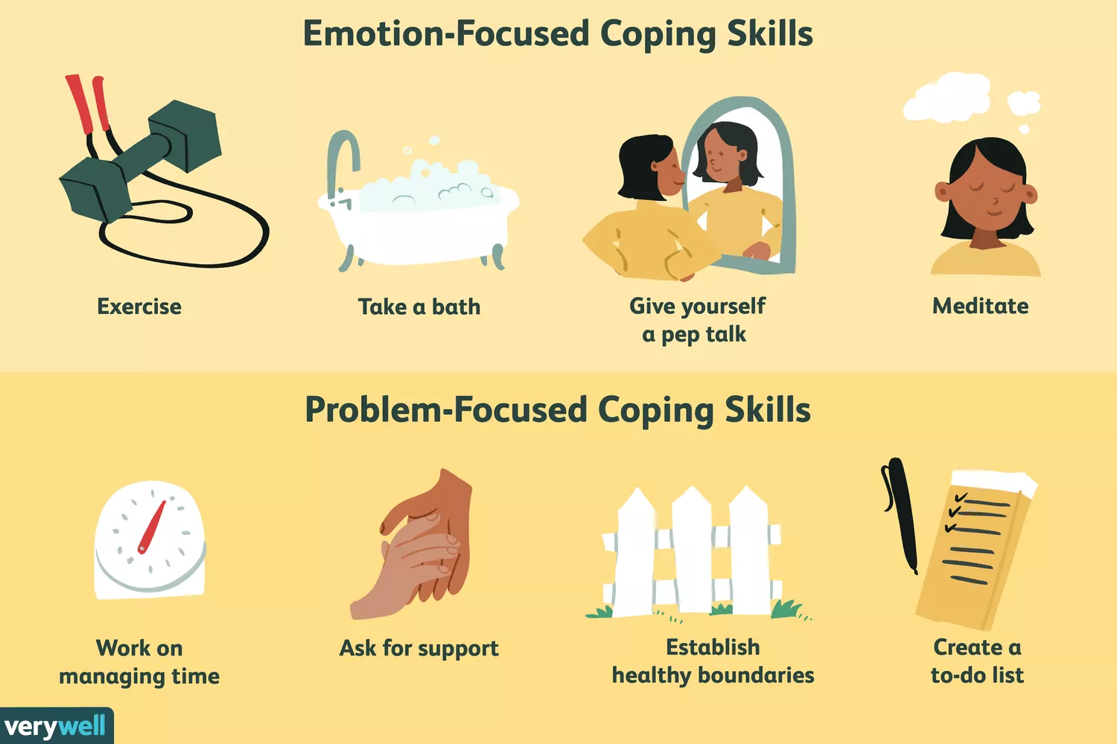
Developing healthy coping mechanisms
Changeable stressors require problem-focused coping
Engaging in actions that can help to address problems that cause stress
Unchangeable stressors require emotion-focused coping
Working to adjust your emotional response to a stressor
Stressful situations often require both types of coping
Notes:
Gabriela
Problem-based coping: helpful when you need to change the situation
For example, by removing a stressful thing from your life
For example, if in an unhealthy relationship, your anxiety and sadness might be best resolved by ending the relationship (as opposed to soothing your emotions)
Engaging in activities (such as tutoring or working with a study group) to help improve performance in a class
There are many ways you might decide to tackle a problem head-on and eliminate the source of your stress. In some cases, that may mean changing your behavior or creating a plan that helps you know what action you’re going to take.
In other situations, problem-focused coping may involve more drastic measures (like changing jobs, cutting someone out of your life)
Healthy problem-focused coping skills:
Ask for support from a friend/professional
Create a to-do list
Engage in problem-solving
Establish healthy boundaries
Walk away (leave a situation that’s causing stress)
Work on time management (turn off phone notifications)
Emotion-based coping: helpful when you need to take care of your feelings when you either don’t want to change your situation or when circumstances are out of your control
For example, if grieving the loss of a loved one → important to take care of your feelings in a healthy way
Seeking social support from friends and loved ones
Engaging in therapy to gain psychological support for a change or loss
Emotion-focused coping skills can help you deal with your feelings in a healthy way
Healthy coping strategies may soothe you, temporarily distract you, or help you tolerate your distress
While it’s important to use coping skills to help relieve some distress, coping shouldn’t be about constantly distracting you from reality
Coping strategies may help you change your mood (i.e. after a bad day in lab)
Clean the house/apartment (a closet, drawer, area)
Cook a meal
Draw
Garden
Meditate
Play with a pet
Engage in a hobby
Go for a walk
Practice breathing exercises
Reframe the way you are thinking about the problem
Spend time in nature
Journal
Stressful situations often require both types of coping:
Stress from performing poorly in a class → seek social support (emotion-focused coping), even though problem focused learning (how to study more effectively) is the type of coping that will ultimately help you change the stressful situation

Slide 13
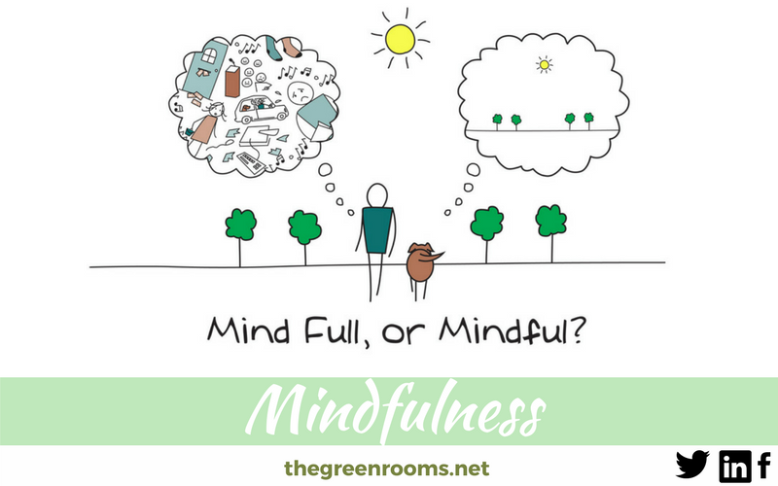
What is self-care and mindfulness?
Self-care: the activities we deliberately do in order to take care of our health
Mindfulness: our ability to sit with our emotions without judging them or immediately acting on them
Notes:
Neha
Important to highlight that coping skills are used in response to stressful situations and difficult emotions, whereas self-care is done on a more regular basis to maintain our health and wellness
And regularly developing and utilizing healthy coping skills is an important part of our self-care routine
Self-care can be defined as the activities that we deliberately do in order to take care of our physical, mental, and emotional health and wellness. Self-care can take on a variety of forms, and should become a habit so that when we’re dealing with stress, we remember that, “Hey, I need to take care of myself in this situation.” And, you need a variety of activities to try—if one doesn’t work, you can switch to another.
Doing yoga or knitting isn’t always going to work during acutely stressful times. Important to have an “arsenal” of self-care activities. A “go-to” list of self-care activities for stressful situations.
One tool that can be used together with self-care is mindfulness:
Mindfulness is important in our response to stress. Instead of reacting to stress with maladaptive coping mechanisms, mindfulness helps us slow down, breathe, and respond healthility to the stresses in our lives. Together, mindfulness and self-care can help lessen our stress effects and increase our capacity to respond to stress and complete the task.
Mindfulness is the awareness that arises from paying attention, on purpose, in the present moment, and non-judgmentally
Focused attention (one thing at a time)
Purposeful action (do it on purpose - a voice within that says I’m going to mindfully eat my lunch, be fully present as I eat)
Grounded in the current experience (being where you are in the present moment)
Held with a sense of curiosity (open and non-judgmental to what’s here)
Mindful of what’s going on both internally and externally
Mindfulness is the basic human ability to be fully present, aware of where we are and what we’re doing, and not overly reactive or overwhelmed by what’s going on around us.
Ability to acknowledge when we’re sad, frustrated, angry, sad, and happy - and to be with those emotions non-judgmentally
Whenever you bring awareness to what you’re directly experiencing via your senses, or to your state of mind via your thoughts and emotions, you’re being mindful

Slide 14
How can we practice self-care and mindfulness?
Physical: getting enough sleep and proper nutrition, moving your body (exercise, going for a walk)
Emotional: seeing a therapist, developing hobbies like writing in a journal
Social: attending a virtual happy hour with friends
Mental: learning a new subject, maintaining a healthy inner dialogue
Spiritual: journaling, yoga, mindful meditation
https://umwellness.wordpress.com/8-dimensions-of-wellness/
Notes:
Neha
Circle back to those 8 dimensions of wellness (note: this is the same figure shown on slide #6) - we want to use self-care to address and attend to each of the dimensions of wellness. So there’s lots of varied options for how to practice self care.
Physical self-care:
Activities you do that improve the well-being of your physical health
You need to take care of your body if you want it to run efficiently. Keep in mind that there's a strong connection between your body and your mind. When your caring for your body, you'll think and feel better too.
Make sure you’re getting enough sleep and maintaining proper nutrition. Physical self-care can also be moving your body in a fun and mindful way, such as yoga or going for a walk.
Emotional self-care:
It's important to have healthy coping skills to deal with uncomfortable emotions, like anger, anxiety, and sadness. Emotional self-care may include activities that help you acknowledge and express your feelings on a regular basis.
Whether you talk to a partner or close friend about how you feel, or you set aside time for hobbies that help you process your emotions, it's important to incorporate emotional self-care into your life.
Seeing a therapist, writing in a journal, utilizing healthy coping mechanisms, and managing stress.
Social self-care:
Activities that nurtures and deepens the relationships with people in your life.
Virtual happy hour with friends, making time to call your family members regularly
Everyone has slightly different social needs. The key is to figure out what your social needs are and to build enough time in your schedule to create an optimal social life.
Here you can talk about the importance of developing and maintaining a social support system - connect virtually with others in your cohort, people in your lab, others within and outside of Penn, sign up for your graduate group peer support network (I know CAMB/DSRB has one, not sure about other programs)
People who are outside the research environment can also be insightful and supportive
Mental:
Mental self-care includes doing things that keep your mind sharp, like puzzles, or learning about a subject that fascinates you. You might find reading books or watching movies that inspire you fuels your mind
Mental self-care also involves doing things that help you stay mentally healthy. Practicing self-compassion and acceptance, for example, helps you maintain a healthier inner dialogue.
Spiritual:
Research shows that a lifestyle including religion or spirituality is generally a healthier lifestyle.
Nurturing your spirit, however, doesn't have to involve religion. It can involve anything that helps you develop a deeper sense of meaning, understanding, or connection with the universe.
Practice mindful meditation
Goal is not to stop our thoughts, but rather to not get caught up in them, to notice them but not react them
https://medium.com/@wendymillermeditation/5-types-of-self-care-and-practice-ideas-for-each-9e88a61c6bb0

Slide 15
Tips for self-care and wellness during grad school
Start and end your day with a relaxing activity or ritual
Maintain separation between home and lab
Incorporate mindfulness into your everyday life
Unplug from technology daily
Set boundaries and be assertive in prioritizing your well-being
Tell someone if you’re feeling stressed
Take breaks and time off
Utilize support systems
Source: Andrea Gray
The Rutgers iJOBS Blog
Notes:
Neha
More specific self-care tips for grad students in the midst of the pandemic
Start and end your day with a relaxing activity/ritual
Example: I used to wake up and check my email on my phone before even getting out of bed, immediately putting myself in work mode. Try taking even just 15 minutes to do some yoga, journaling, reading, or mediation before you jump into the day’s tasks or turn in for the night.
Separation of home and lab.
During normal times: worries about research and personal things get blurred into one ball of anxiety. One way to prevent this is to leave lab at lab.
How to manage this during pandemic? Have a stopping point at the end of the day - close the laptop, don’t check emails, if possible turn off Slack notifications (if possible, work from a different room than you work in)
Really want to stress the importance of work-life balance - this can be harder when working from home/virtually, know when to stop working
Incorporate mindfulness into your everyday life
Can be meditation, or can simply be inserting short pauses into everyday life (i.e. taking breaks after each zoom meeting to reset)
Merging meditation practice with other activities such as yoga or sports
Unplug from technology daily.
In today’s world, it’s harder and harder to detach from our phones, computers, emails, and social media. But try to find some time each day to power down and disconnect. (avoid excessive exposure to media coverage - especially important given pandemic)
Set boundaries and be assertive in prioritizing your well-being.
It’s important to set boundaries both in lab and in your personal life
This includes saying no to some side projects or more undergraduate students.
This is immensely easier to say than do, particularly with PI’s of varying personalities, but it can be worth it.
More abstractly, set boundaries with your project, meaning that you don’t allow it to be connected so deeply with your self-worth.
Tell someone!
Some of the most damaging and dangerous signs of stree or burnout are not visible. The person in lab with the biggest smile could be going through immense turmoil.
So if you are experiencing a lot of stress and are feeling overwhelmed, it is imperative to let someone know, including your graduate group chair or PI.
Take breaks and time off.
To prevent drainage of your resources, time off is essential to recharge.
This doesn’t have to be 2 weeks of vacation, but taking evenings or a weekend to do something fun, relaxing, or creative can prevent having to take 3 months off after burnout. Don’t worry; you will not add another year in grad school because you went camping last weekend.
Utilize support systems.
You may feel the desire to isolate yourself to keep people from further draining on your resources, but the opposite is what is needed.
Support systems come in many different forms, including friends, family, mentors, counselors, and pets too.
CAPS provides free counseling to students and can be a major part of stress management.

Slide 16
Take Home Messages
Wellness is critical to living a higher quality life
Our wellness can be challenged by stressors, such as imposter syndrome
We can combat stressors developing healthy coping mechanisms and practicing a regular self-care routine
Notes:
Hannah
Maintaining wellness is critical to living a higher quality life (both in graduate school and beyond). To be a good scientist, it’s critical to take time for ourselves away from science, to find balance, and prioritize our own well-being. Our wellness can be challenged by stressors and feelings of imposter syndrome, but by developing healthy coping mechanisms and practicing regular self-care routines we can tackle these difficult situations.

Slide 17
Resources
Penn
Counseling and Psychological Services: https://caps.wellness.upenn.edu/
Student Health Service: https://shs.wellness.upenn.edu
Campus Health: https://campushealth.wellness.upenn.edu/
Wellness at Penn: https://www.wellnessatpenn.com
Courses:
MED 589: Mindfulness Meditation and Mind-Body Medicine
Mindfulness-Based Stress Reduction (MBSR) workshops (offered through CAPS)
The Penn Program for Mindfulness: http://bit.ly/PennMindfulness
Other
NIH Office of Intramural Training and Education
Dr. Sharon Milgram (@sharonmilgram) - “Becoming a Resilient Scientist Series”
www.training.nih.gov
Notes:
Hannah
MED589: mindfulness and mind-body medicine (whole semester, meets multiple times per week, day long meditation retreat)
(lower-commitment options from CAPS)
We’ve provided a really basic introduction to some of these concepts. And developing wellness and self-care takes time, practice, and oftentimes, help from others. It’s important to recognize when you need help, and at Penn we have lost of resources to help students. Including: PSN, CAPS, SHS, etc.
CAPS has a ton of resources for mindfulness and self-care
Wellness at Penn - provides support, resources, and practical tools for wellness across the Penn community
Also, point out that the NIH OITE youtube page has all the previous seminars/lectures recorded and loaded
Sharon Milgram does an amazing job discussing personal wellness/self-care and how that can integrate into and improve our science/professional lives

Slide 18
References
Wellness at Penn (2020). https://www.wellnessatpenn.com/about/
Scott, E. (2020). 5 Self-Care Practices for Every Area of Your Life. https://www.verywellmind.com/self-care-strategies-overall-stress-reduction-3144729
Gray, A. (2015). Stress and Burnout in Graduate School: Recognizing, Preventing, and Recovering. http://ijobs.rutgers.edu/wordpress/author/andreag/
Miller, W. (2019). 5 Types of Self-Care (And Practice Ideas for Each!). https://medium.com/@wendymillermeditation/5-types-of-self-care-and-practice-ideas-for-each-9e88a61c6bb0
Kaatz, A. (2018). Coping Efficacy.
Branchaw, J. L., Butz, A. R., & Smith A. (2018). Entering Research (2nd ed.). New York: Macmillan.
Sheridan, M.J. (2020) Stress Management and Wellness for Scientists workshop. NIH OITE
Milgram, S. L. (2020) Becoming a Resilient Scientist. NIH OITE

Slide 19
Questions?
Type them into the chat box!

Slide 20
Break!
Please stay on Blue Jeans
Meet back at 3:00PM

Slide 21
Breakout Sessions

Slide 22
Outline of Today’s Breakout Sessions
Introductions
Self-Reflection Activity: “What does self-care mean to you?”
Activity #1: Wellness Assessment
Activity #2: Life Tracker
Activity #3: Developing healthy coping mechanisms
Technical notes:
Do not hit “End Session” on Blue Jeans
Remember your breakout room number
Notes:
General comments for breakout sessions:
We want to keep the breakout sessions open and relaxed. Allow the conversation to flow naturally and go at your own pace.
Explain to them that we’re providing this outline, but we’re not obligated to get to everything that’s planned out
You can encourage students to use camera (but don’t force anyone to use camera if they’re not comfortable using it)
Students should not be forced to answer a question if they don’t want to.

Slide 23
Introductions
Name/Program/Interests
What’s one thing you’re excited for in graduate school?
Have you binged any good TV shows or read any good books during quarantine?
What’s your spirit animal?
Notes:
Instructions for Breakout Leader:
To start out, it may be best to not share your screen, so that you can see the students’ faces. You can paste questions into the chat box. Whatever you feel comfortable with as moderator.
Begin by introducing yourself and thanking the students for participating in the breakout session.
Remind them to write down or make note of their breakout room number in case they get kicked out and need to rejoin the room.
Then, ask the students to share their Name/Program/Interests, and to answer any of the other three questions listed above (keep it open-ended, students can answer any or all of the questions).
Don’t rush the students if they want to talk more and interact with each other, if they want to discuss their COVID-19 experience

Slide 24
What does self-care mean to you?
Notes:
Instructions for Breakout Leader: This should be the first self-reflection activity. Open up the floor to a discussion of self-care. Ask the students what self-care means to them. This can be a more open-forum. See below for more questions to ask if students are hesitant to start talking. You may also want to begin by sharing what self-care means to you and provide examples of how you practice self-care as a graduate student.
Questions to ask if the conversation is slow to start or to keep the conversation going:
What hobbies do you do for fun? What do you do outside of science?
What things do you do for your self-care on a regular basis?
Why do you think self-care is important?
Can you share an experience in the past when self-care was really important for you?
What are some barriers to maintaining self-care strategies?
How will I address these barriers and remind myself to practice self-care?
How do you think self-care will change during graduate school? Or during stressful situations?
At the end of the session, can ask what things will you try to add to your self-care routine?
Important points to share with students:
It’s a good idea to practice self-care now, (hopefully) before things get too stressful
It’s good to try our hand at different types of self-care activities - see what works for us, so that we have an “arsenal” of activities to turn to when we need to cope with stressful situations.

Slide 25
Activity #1: Wellness Assessment - Body
Never 1……….2……….3……….4……….5 Always
I am getting enough sleep (7-9 hours)
I am eating balanced, nutritious meals
I am getting regular exercise
I take care of myself when I am sick, need rest, or just need a break
Source: Dr. Sharon Milgram, Director of NIH OITE
Notes:
Instructions for Breakout Leader:
Explain that wellness is defined as the things that we do to maintain our body, mind, heart, and spirit.
Explain that maintaining wellness and self-care is critical for being a resilient scientist - for being able to work through and grow from adversity and difficult situations. That in order to do well, we need to be well.
So we want to complete this self-assessment to see where we are with our own wellness, while considering the four tenants: body, mind, heart, and spirit.
Ask the students to think about how they’ve been over the past 2 weeks as we consider each bullet point. You may want to walk through the first bullet point with them: if you’ve gotten 7-9 hours of sleep every night for the past 14 nights, then you’d rate yourself a 5. If you’ve never gotten enough sleep for the past 14 nights, then you’d rate yourself a 1. If somewhere in between, rate between 2 and 4.
Some tips: your first response is probably the most accurate, so go with that response and don’t overthink. Be honest with yourselves - no one will see this except you.
Read through the next four slides with the students. Ask them to consider where they fall for each bullet point on a scale from never (1) to always (5).
Students can keep a mental checklist, or write down their scores as we go (or keep track on the notes section of their phones).
You don’t need responses from the students on each slide, because there will be follow up questions at the end.
Ask them to keep note of any score that stands out to them as we move through the four slides.

Slide 26
Activity #1: Wellness Assessment - Heart
Never 1……….2……….3……….4……….5 Always
I’m in touch with and let myself feel all my emotions
I reach out to others for support when I need it
I make time to spend with my family and friends
I engage in activities that are fun and relaxing
I demonstrate compassion for myself and others
Source: Dr. Sharon Milgram, Director of NIH OITE

Slide 27
Activity #1: Wellness Assessment - Mind
Never 1……….2……….3……….4……….5 Always
I avoid getting caught up in perfectionism
I avoid negative or deceptive self-talk
I practice self-affirmations and positive self-talk
I avoid judging myself compared to others
Source: Dr. Sharon Milgram, Director of NIH OITE

Slide 28
Activity #1: Wellness Assessment - Spirit
Never 1……….2……….3……….4……….5 Always
I feel connected to something that is bigger than me - however I define that
I seek out resources that nurture me spiritually
I reflect on and invest in what is meaningful to me
I read writings or watch media that are inspiration to me
Source: Dr. Sharon Milgram, Director of NIH OITE

Slide 29
Activity #1: Wellness Assessment - Follow Up Questions
As you went through the assessment questions, did anything stand out to you?
What are you pleased about in your wellness practices?
What would you like to change?
What are some barriers to making these changes? How can we deal with these barriers?
Source: Dr. Sharon Milgram, Director of NIH OITE
Notes:
Instructions for Breakout Leader: Finish up this activity by asking the students to share if anything stood out to them during their wellness assessment. Share your own findings, if they are slow to talk.
Other questions to ask:
Does anyone want to comment on a surprising score they received on one of these topics?
Where am I doing well? Where would I like to improve?
What is something I can do now to improve my wellness/self-care practice?
Think about the times in your life when you have felt most healthy. What are some characteristics of that?
If comfortable, can also talk about when you felt unhealthy, but wouldn’t push this on anyone
For the “body” tenant, you can go deeper by asking how can one have a balance diet? How can we incorporate regular exercise into graduate student life?
Point out that the Graduate Student Center offers virtual yoga sessions, taking time to go for walks to explore Philly (there’s a self-guided tour of Philly linked on the Penn Grad Center website: https://gsc.upenn.edu/online#virtual), etc.

Slide 30
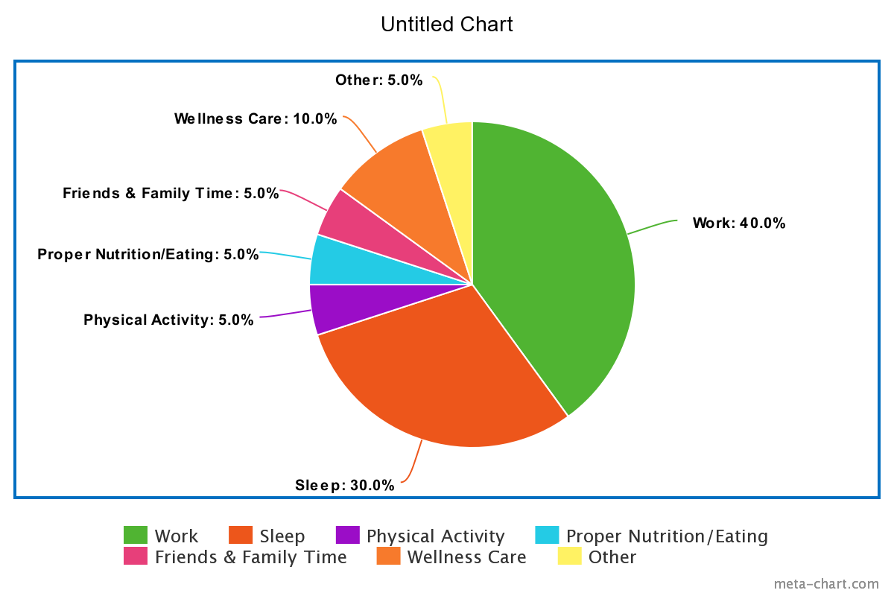
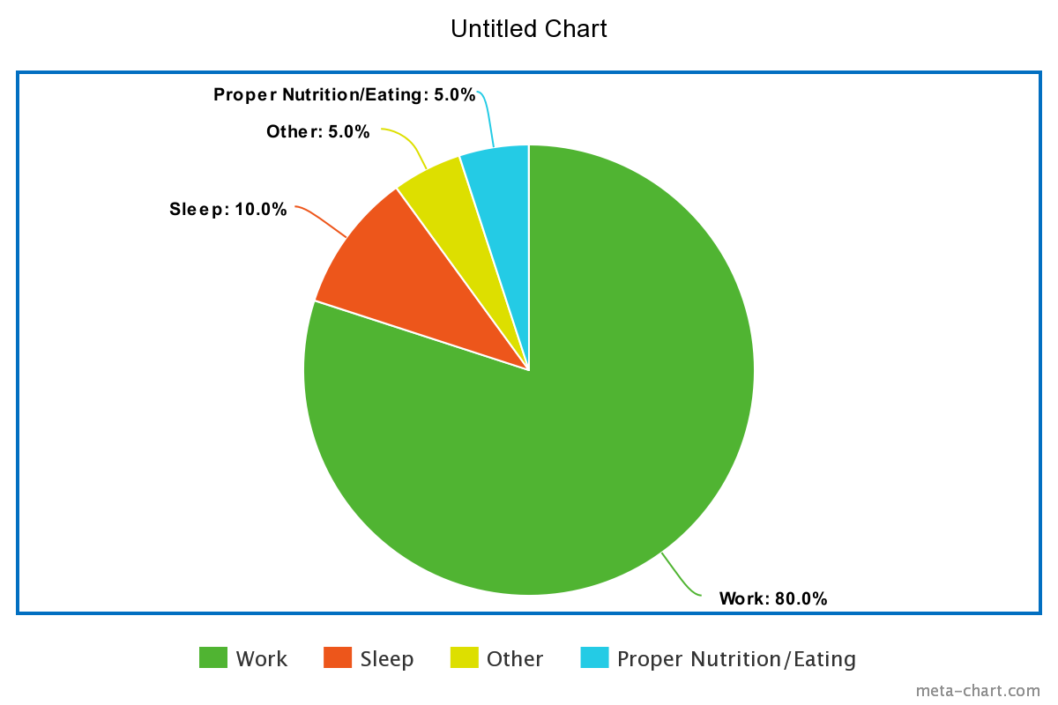
Activity #2: Life Tracker
Consider your typical week. How much time do you spend on the different dimensions of wellness?
Notes:
Instructions for Breakout Leader: Ask the students to consider their typical week (or what they expect to be a typical week in graduate school). Ask them to think of their time in a pie-chart format. You can recommend that they even sketch out their pie-chart quickly on a piece of paper. Ask the students to consider how much time they spend on each of the categories shown above in the left-hand pie-chart. To help with the conceptualization of this task, you can breakdown a 24 hour day for the students: (stress that this is an example 24 hour period - not everyday will look like this)
Chart on left is one way that time can be broken down. In general we want something more balanced, flexible. Lab environment can also play into this and how our pie chart looks.
“Ideal” is different for everyone, can be something is flexible. Ideal can be learning to listen to your body, picking up on when you need to re-balance - attend to different dimension of wellness. Not attracted to one extreme or another. Balance (might need something different on one day compared to another). It’s subjective - ideal is different for everyone (try not to compare your day to others). Encourage them to do this kind of activity every once in a while - how am I allotting my energy?
Example -
7 hours sleeping
10 hours in lab/coursework
1 hour eating/maintaining proper nutrition (physical wellness)
1 hour of exercise/physical activity (physical wellness)
1 hour of friends and family time
3 hours of wellness care:
Point out that this can be broken down into different categories based on the dimensions of wellness/self-care
Emotional: attending a therapy session, developing hobbies, watching TV!
Intellectual: learning a new subject, volunteering for an organization, hobbies
Spiritual: meditation, hiking/going out into nature, praying, yoga
Occupational: time for career development/personal growth
Point out that this also includes activities you do to relax, to relieve stress or use coping mechanisms. Time to unplug from the world or get away from technology
1 hour spent on “other” activities
Commuting to work, showering/hygiene, getting ready in the morning, etc.
Questions to ask to get the conversation going:
Ask the students to reflect on their pie-chart?
What do you notice about the pie-chart on the left? What do you notice about the pie-chart on the right? Is the pie-chart on the right sustainable?
How is your pie chart balanced? Do you think you tend to spend more time in the left pie chart? The right pie-chart? Somewhere in between?
How do you envision this pie chart changing as you begin graduate studies?
How do you envision this pie chart changing during stressful times?
Are there any situations coming up that you envision challenging/straining the balance? How can we address these challenges?
Why do you think it’s important to consider our time in this way?
What is something outside of lab that you are willing to prioritize for your wellness?
Important Points to Share with Students:
Stress the importance of work-life balance. Of taking a holistic approach to wellness.
You can note that it’s important to develop an identity for yourself that isn’t tied to your performance in lab. Having a balanced pie-chart and taking time for these other aspects of wellness can help separate yourself and your self-worth from lab/work.
Note that there may be times when the pie chart is 80% science/lab (right-hand pie-chart shown above). And that’s okay. But it’s important to recognize that those times should occur for short bursts, and that that kind of “pie-chart” is not sustainable.
Note that in general, the percentages for each sector can change and should be flexible.
But on the whole, we want there to be balance among the different dimensions of wellness
Mention that it’s important to talk to your mentor about these things. When thinking about rotation labs, take time to ask what their expectations are. Ask other students in the lab as well. For example, students should consider their needs and ask whether they align with their PIs expectations. Questions students can consider asking include:
How often are you expected to be in the lab? (What about weekends?)
Do you feel comfortable with the mentor? Could you see yourself effectively communicating with them?
What about the balance between coursework and lab work?
Happiness/Stress level of other students, employees of the lab?
You can also recommend the Life Cycle app on their phones. You can use this app to help track your days and look at trends in your week. You can set goals for yourself. If you have a stressful week, you can look back at the app and see how you spent your time - what was different about this week that made it stressful?

Slide 31
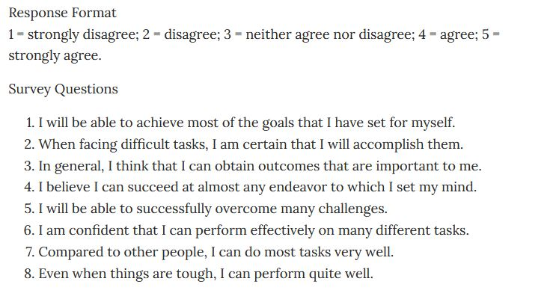
Activity #2: Measuring Self-Efficacy
I think we can take out this slide/activity since we’re not focusing on self-efficacy as much during the large-group session. Replace this activity with the “Wellness Assessment” activity from Dr. Sharon Milgram
Notes:
Self Efficacy- the belief in one’s self to succeed. This plays a key role in how we think and feel (our confidence in ourselves). Let's use this small quiz to measure baseline levels of self efficacy within ourselves. Answer the following questions using the scale above for level of agreement with each statement. Add the total points at the end. The higher the score the higher your baseline level of self-efficacy is.
https://positivepsychology.com/self-efficacy-scales/

Slide 32
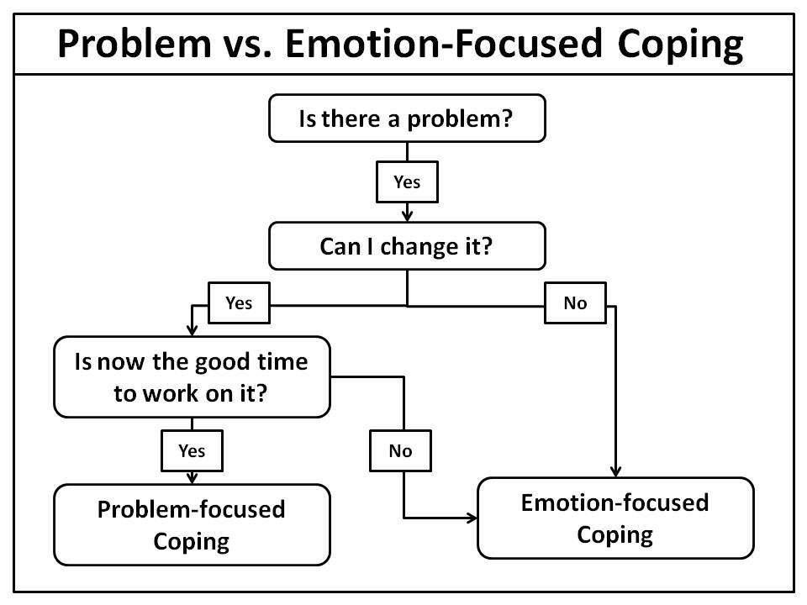
Activity #3: Developing healthy coping mechanisms
Reflect on a time when you were in a challenging situation.
Was it a changeable or unchangeable situation? Both?
How did you handle the situation?
Did you use the most beneficial coping strategies?
If not, what would you do differently?
stresstostrength.com
Notes:
Instructions for Breakout Leader: Begin by reminding students that when we’re stressed, we need to employ the correct coping mechanisms to help alleviate the stress, solve the problem, or complete the task. We begin by determining that there is a problem, and asking whether it can be changed. If the problem or situation cannot be changed, we utilize emotion-focused coping. This can include: engaging in a hobby, going for a walk, or practicing breathing exercises. We also use emotion-focused coping if the problem can be changed, but it’s not a good time to work on the problem. If the problem can be changed and if it is a good time to work on it, we use problem focused coping. This can include: asking for support from a friend or professional, creating a to-do list, or engaging in problem-solving.
Ask the students to reflect on a time when they were stressed and to consider the following questions. (You can also ask students to think about a stressful situation that they may be anticipating in graduate school).
Was it a changeable situation?
Was it an unchangeable situation?
Was it a little bit of both?
How did you cope with the stressful situation?
Did you use the most beneficial coping strategies? Why or why not? What would you do differently?
Ask whether any student would like to share their experience.
How did utilizing coping mechanisms help you through the stressful situation?
Is there anything you would do differently now that we’ve learned more about coping mechanisms?
How do you envision using coping mechanisms in the future?
Do you have any questions about coping mechanisms? Resources at Penn to help with coping?
If students are slow to talk, you can begin by providing them with a situation that a graduate student may find themselves in, and then ask the students how they would deal with this situation. For example, provide the following scenario:
You find yourself doing poorly in Cell 600, maybe you received a grade lower than you were expecting on the first exam. You find yourself stressed by this situation. Ask the students:
Is there a problem?
Is it a changeable or unchangeable situation?
Consider the following coping options:
It’s a changeable situation, so can use problem-focused coping by:
Reaching out to the TA, professor, or PI to ask for help
Setting up a virtual study group with friends
Finding a tutor (for example, through Weingarten Learning Resources Center)
You can also use emotion-focused coping by:
Talking to trusted friends or family members about your struggles - they can provide support or advice for how to cope with the situation
Talking with a peer mentor through individual graduate groups/PSN or a professional counselor through CAPS

Slide 33
Important points to discuss with students
When deciding on rotation and thesis labs, consider your needs when it comes to wellness and self-care. Do they align with the PI’s expectations?
How often are you expected to be in the lab? (What about weekends?)
Do you feel comfortable with the mentor? Could you see yourself effectively communicating with them?
What about the balance between coursework and lab work?
Happiness/Stress level of other students, employees of the lab?
Emphasize the need to develop a strong social support system.
Why is a social support system important?
How can one develop a social support system virtually?
How was this done pre-pandemic? (and how can this be done post-pandemic?)
Notes:
I think it’s important to normalize getting help and going to CAPS - there’s still a stigma around mental health, so if during the breakout sessions, we can talk about our own experiences (if we feel comfortable). Hammer in that it’s okay to go to CAPS, and it’s okay to go even if things don’t feel that bad (i.e. get pre-emptive help).
Things to consider for “emphasize the need to develop a strong social support system”:
A social support system is important to:
Help combat imposter syndrome (talk about your fears with) and to develop self-efficacy (see how your peers can tackle stressful situations, can help you feel empowered or ask them for help)
Schedule group study sessions over Zoom
Schedule/attend Zoom happy hours (with cohort, labmates in your rotation lab)
Pre/post pandemic - join clubs/organizations (can even do this now, since a lot of organizations have transitioned to virtual meetings)
Join a mentoring organization as a mentee (PSN, individual graduate groups have programs), or seek help at CAPS (CAPS offers some group counseling sessions, or can speak with a counselor)

Slide 34
Questions to ask students if conversation lags
What are some barriers to self-care and wellness?
Expectations of your PI, your own expectations, culture within academia (publish or perish), family responsibilities, etc.
What was a time in your life when you felt supported and well?
Behaviors you practiced, people you were close to, how you were treated and how you treated others
What would it look like to be supported?
What resources do you envision using during stressful times?
CAPS, PSN, Student Health, your cohort, your graduate group chair, your PI, others in your lab, friends and family

Slide 35
Volunteers: to consider before breakout sessions
What are some stressful times that I have experienced since joining Penn? How did I cope or practice self-care during these stressful times?
Since joining Penn, what have I learned about self-care? How do I practice self-care regularly?
Notes:
I thought it could be helpful to do some self-reflection before the breakout sessions. I definitely tend to think better when I’m not in a room full of people, so it may be helpful to have some examples prepped before the breakout session that I can share with the incoming students

Slide 36
Wrap-Up Session

Slide 37
(word generator of common themes that came up during breakout sessions)

Slide 38
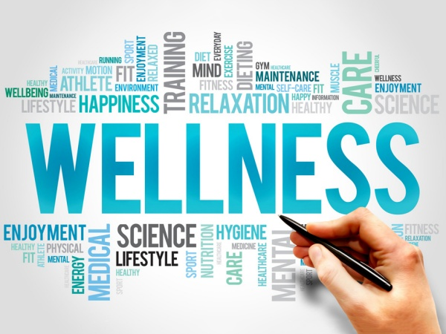
https://elgl.org/finding-sanity-during-an-insane-time/
Notes:
Hannah
Thank you for participating today. We hope you come away with a basic understanding of wellness, why it’s important to consider our well-being holistically, and how we can use self-care routines to attend to our wellness. We also hope you learned a bit about how to use effective coping mechanisms to manage stressful situations.
Please reach out to the Peer Support Network, your graduate group chair and cohort, or other resources at Penn for help.

Slide 39
Social Activity (optional for students)

Slide 40
Conversation Starters
Introductions
What’s your first trip once this is all over?
What did you do on your last vacation?
Show-and-Tell: pet edition! Do you have any pets? Can you show them to us?
Open the floor for general questions about grad school and Philly
Notes:
PSN panel → ask questions, anything you want to know
Which places are semi-open?
Outdoor yoga classes hosted by Penn?
Grad student center → virtual yoga
Tell them which emails to look out to (Monday BGS updates, career dev., Grad student center, GAPSA newsletter for virtual events, Locust Walk)
Coronavirus resources/information
Write down questions we don’t know the answer to → we can get their questions answered
Questions students may have:
Any good restaurants
Things to do for fun outside
What do we do outside of lab for fun? (intramural sports, clubs/activities, etc.)

Slide 41
Option #1: Trivia Night!
Facilitator should open the random trivia generator and share their screen
Start asking questions
Have each person send their answer in the chat box
Keep score of who has the most points
https://www.randomtriviagenerator.com/?fbclid=IwAR3mVep1dcLeuN1mxmfoSjKf8iLFwGz3qCV9TMTonNkrkCwuM9ggHnUFtnE#!/
Notes:
The webpage will provide questions from all different categories, but you can also select a specific category if you’d like
Can potentially do teams?
To play trivia on Zoom, open this random trivia generator and start asking questions. Have each person send their answer in the Zoom chat at the same time (or just use the honors system).

Slide 42
Option #2: Scavenger Hunt
During each round, the facilitator will announce an item you must search your house for.
As soon the facilitator announces an item, TURN OFF your camera and begin your search.
The first person to return with the item, turn on their camera, and visibly show the item wins 10 points.
Everyone else that finds the items and shows it on camera receives 3 points.
The game will consist of 10 rounds (or until someone reaches 60 points)

Slide 43
Option #2: Scavenger Hunt
An unopened package of toilet paper
A souvenir from a past vacation
Something science related
An item/piece of clothing with Penn on it
A piece of artwork
Clorox Wipes
A piece of workout equipment
A jar of peanut butter
A candle
A plant
A reusable shopping bag
A decorative pillow
A board game
A coffee mug with a quote on it
A box of band aids
A frozen pizza
A musical instrument
A holiday decoration
A car phone charger
A book with at least 300 pages
Any size or breed of pet
Notes:
When appropriate (and time permitting), take a minute to have people share about their item. For instance, if you ask them to find a souvenir from a past trip, that could be fun to hear about.

Slide 44
Option #3: Pictionary
Divide group into two teams
Open the Pictionary word generator
Choose a team to play first and a designated drawer on that team
The drawer generates a word (on the website) and has one minute to draw that word for their team to guess
If the team guesses the word correctly, they get a point
Alternate between teams and drawers
https://randomwordgenerator.com/pictionary.php

Slide 45
Option #4: JackBox Games
Facilitator should use the screen sharing option to that everyone can see the game
Players can play on their own mobile devices by using a browser and going to Jackboxtv.com. Enter the room number and their name.
Notes:
Start a game on your laptop and use the screen sharing option so that players you’re on a call with can see the game. Everyone can play along on their own mobile devices by using a browser and going to Jackbox.tv. If you’re having difficulty with getting out of full screen mode in the game to get back to your video conferencing screen, go to the game’s settings in the main lobby and turn off “Full Screen Mode.”

Slide 46
Games
We could make our own Bingo boards (each space is something you’ve done, can be creative)
House Party
JackBox Games
Scavenger Hunt
Pictionary
Notes:
Present them with 3 choices - which game do they want to play?
These are just options the leader of each discussion can decide which to include or add others as they wish.

